Slide 1
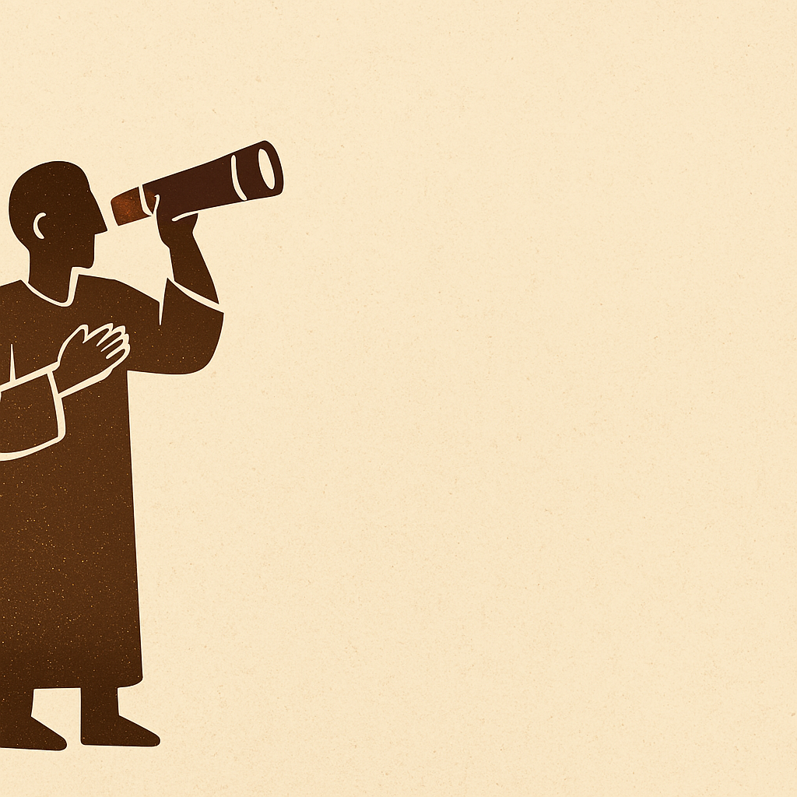
The Prophet
Habakkuk

Slide 2

Needed Background
Timing Leading up to 605 BC, Babylon will soon come against Judah (1:6)
Unique: usually a prophet speaks to people, but Habakkuk speaks to God.
Habakkuk himself?
THE Prophet 1:1, 3:1
Was he a Levite? 3:19, 1 Chron. 25:1ff

Slide 3
Overview & Keys
THE QUESTIONING PROPHET
What about the delay of discipline? 1:4
What about God’s discipline? 1:13 - they are more wicked than us?
1 Babylon to judge!
2 Judgment on Babylon!
3 A song of faith

Slide 4

Big Ideas
Great faith doesn’t lack troubling questions 1:2-4
God can use wrong for right 1:12 (Lk. 15:16, Acts 2:23)
But woes WILL still come upon the wicked 5X: 2:6, 9,12,15,19 (“Lex talionis” 2:8 = Gen. 9:6)
Our many words and God’s few. 2:18-19 versus 2:20.
God has a greater purpose in all this 1:5 (Acts 13:41), 2:13-14

Slide 5
For us today
Don’t use Babylon!? 1:13. Proximal righteousness (Jonah)
Question from humility 2:1
Democracy doesn’t negate God (compare 1:11,16 with 1:5-6, 2:20)
Remember the chesed of God 3:1-2, 15 (Rom. 4:18, Eph. 3:20)
The Philippians of the OT: Where is my strength & hope? 3:16-19

Slide 6

Hear Habakkuk today…
Jesus did fill the earth with the knowledge of the GLORY of YHWH 2:14, Jn. 1:14, Acts 1:8 (Cf. Is. 11:9, 2 Cor 4:6)
One day all will literally KNOW: every knee and every tongue. Phil. 2:10-11
But in the meantime, only those who trust in Him will live (2:4, Rom. 1:16-17)

